Slide 1



In Fields We Roam, Where Data's Sown: Smart Farming, Our Future Grown.
SMART FARM

Slide 2
Agenda
01
02
03
04
05
How it all started
Our Idea
Solution
Future Steps
Demo App

Slide 3
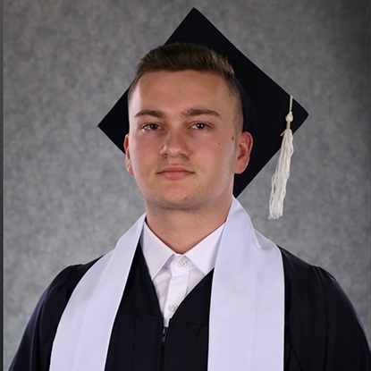
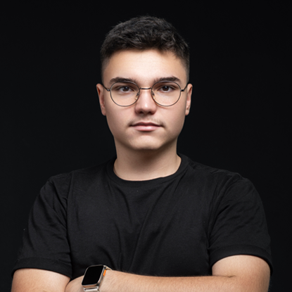
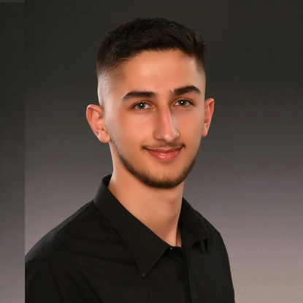
Our team
GENTI NUHIU
JAHJA NUR ZULBEARI
VIGAN DEMIRI

Slide 4
HOW IT ALL STARTED
Concerns about food quality have been on the rise in recent years.
Environmental Factors:
1. Climate Change: Changes in climate patterns can affect crop growth, potentially leading to reduced quality.
2. Pollution: Industrial pollution can contaminate soil and water sources, affecting the quality of the crops grown in those areas.
Farmers often struggle with efficiently managing their resources and making informed decisions due to a lack of real-time data.

Slide 5
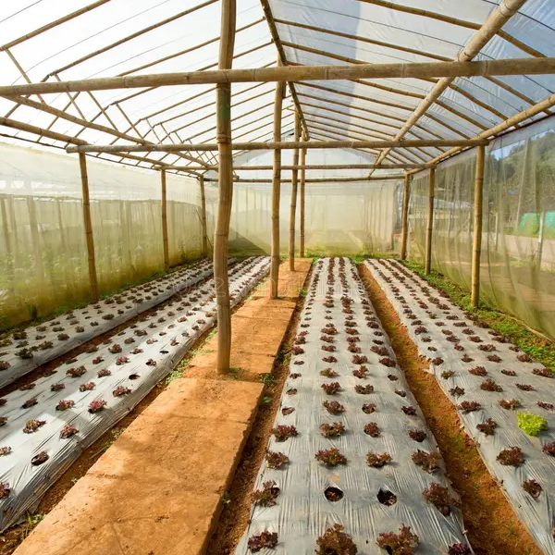

OUR IDEA
In order to prevent this phenomenon, we suggest a web application that will inform agronomists, future investors or large plantation owners about:
- The temperature, CO2 levels and light in their closed farms
- The disease of the plants (if any)
- Recommendations to prevent loss of plants

Slide 6


SOLUTION - MAIN FUNCTIONS
Analysis
Plant Scanning
Gather Data
Feed the AI model with our sensors in the closed fields
The AI Model will generate a report accordingly
*If the results have been dissapointing for a long time – possible chance for plant diseases
The AI Model will detect the type of the disease and recommend your future steps

Slide 7
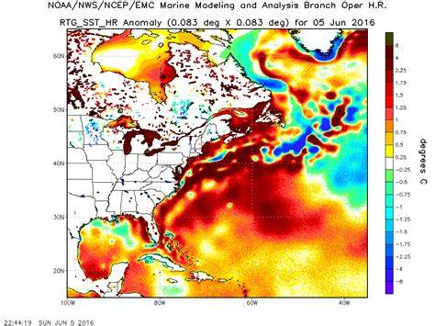
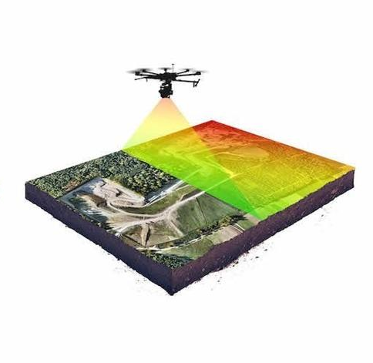
FUTURE STEPS
Mobile App Integration: Develop a mobile app companion to the web platform to access real-time data and recommendations directly on smartphones.
This could include features like push notifications for critical alerts and on-the-go monitoring.
Scanning Future of Plants
Image processing generating of the plantation

Slide 8
DEMO

